Slide 1
AdVECT NEP and FSP radiator literature review
Jahnavi Sinha

Slide 2
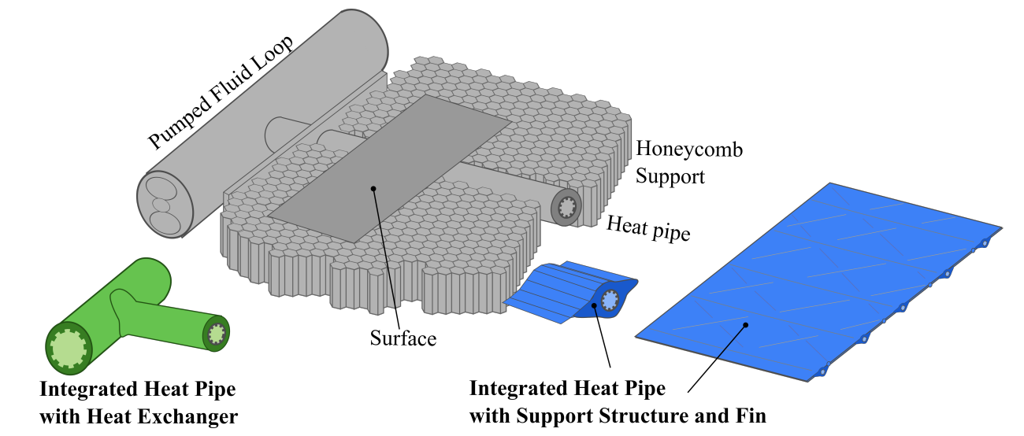
Project Overview
Using additive manufacturing with porous ceramic to develop low mass (< 2 kg/m²), high temperature (> 500 K) embedded heat rejection systems
Applications in nuclear power systems in space
Ceramic manufacturing plan underway, investigating potential heat pipe designs
Fig 1: Integrated design concept of AdVECT using AM

Slide 3
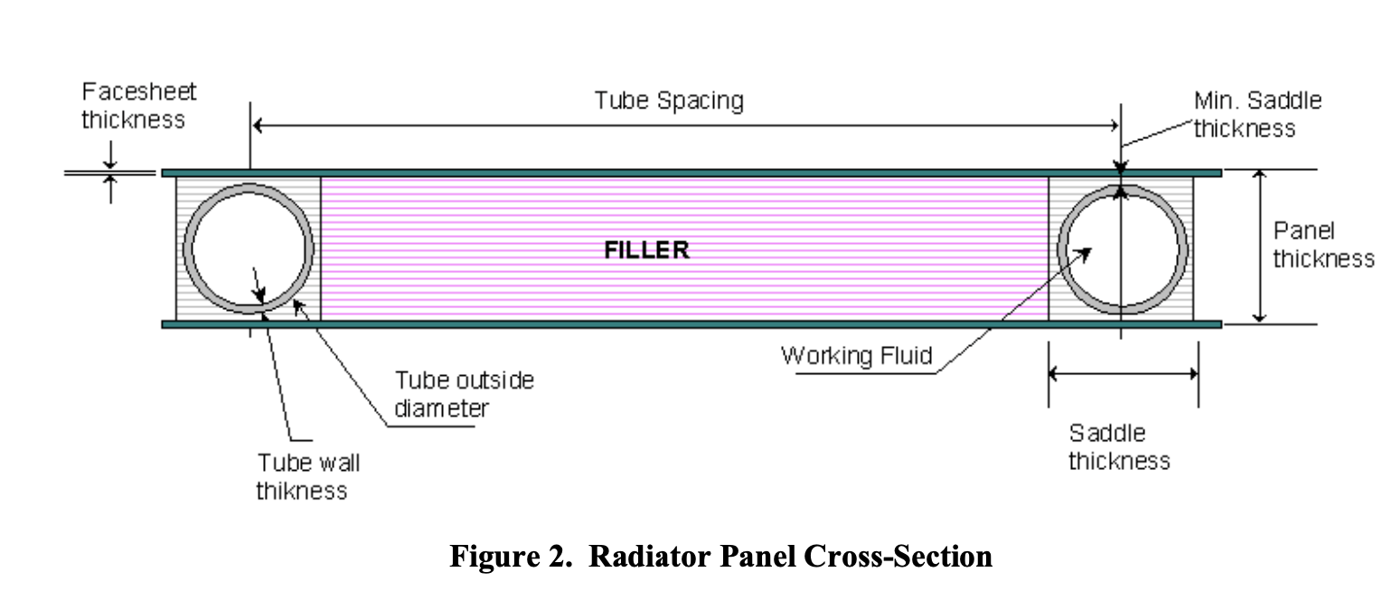
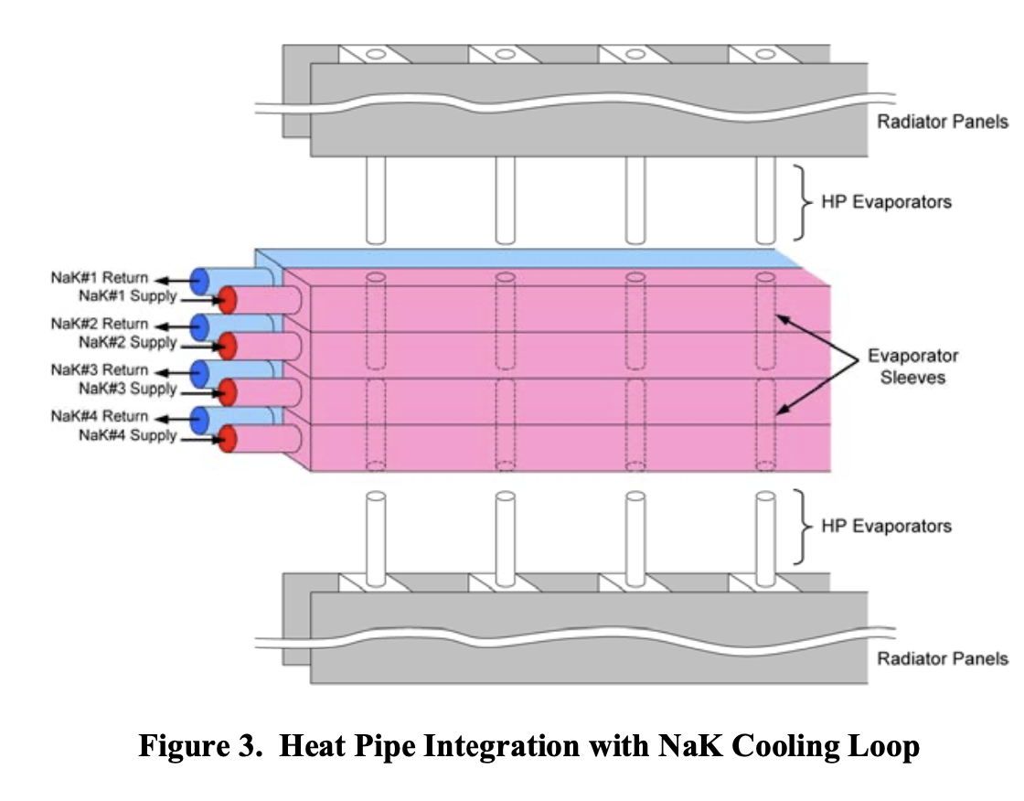
Brayton Power Conversion Systems + Design

Slide 4
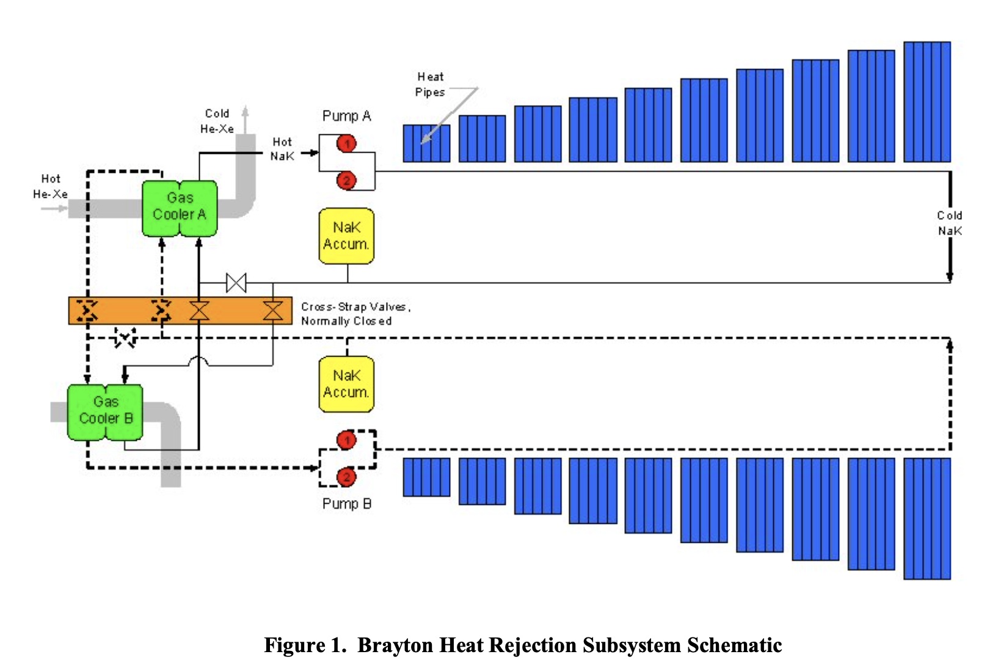
Heat Rejection Concepts for Brayton Power Conversion Systems
Authors: John Siamidis (Analex Corporation), Lee Mason, Duane Beach, James Yuko (NASA Glenn)
Summary:
Evaluates design parameters of 100 kWe Brayton power system with pumped NaK loop (heat pipe diameter, heat pipe spacing, facesheet thickness)
Potential structural variations include tailoring pipe diameter and spacing based on operating temperatures and fin efficiency

Slide 5
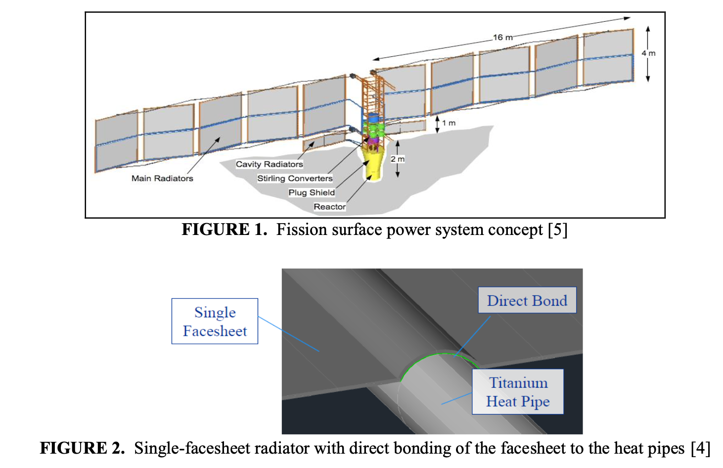
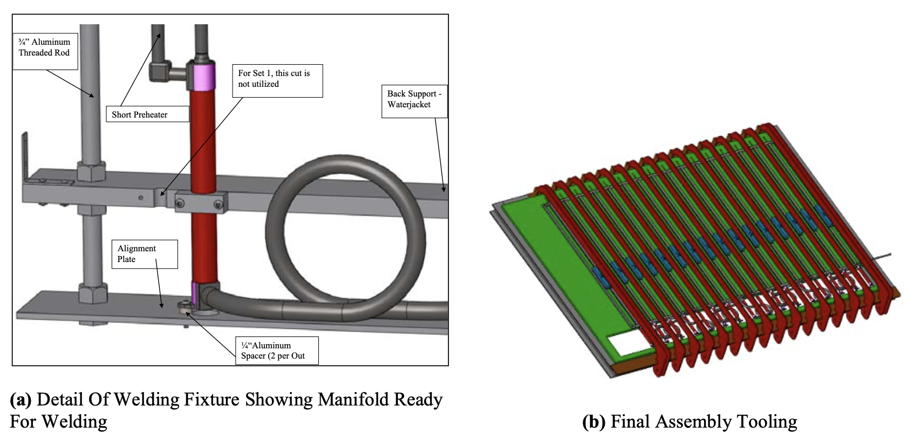
Fission Surface Power Concept

Slide 6
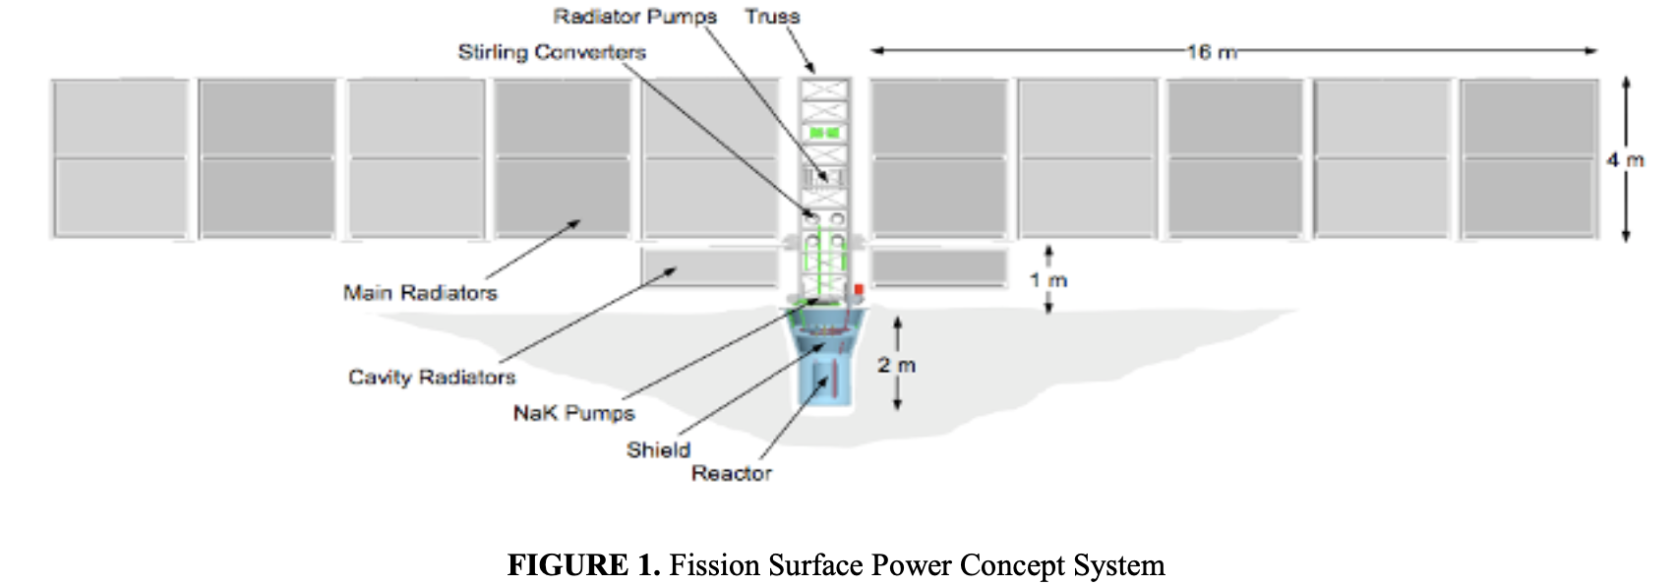
Recent Advances in Power Conversion and Heat Rejection Technology for Fission Surface Power
Authors: Lee Mason (NASA Glenn)
Summary:
UO₂ fuel pins in a cylindrical core with external drum reflectors
Heat transferred to Stirling power converters by pumped NaK loop which generate single phase AC output that is converted to DC
Waste heat removal by pumped water coolant loop coupled to a series of two-sided vertical radiator panels (Ti-water heat pipes in a composite facesheet sandwich)

Slide 7
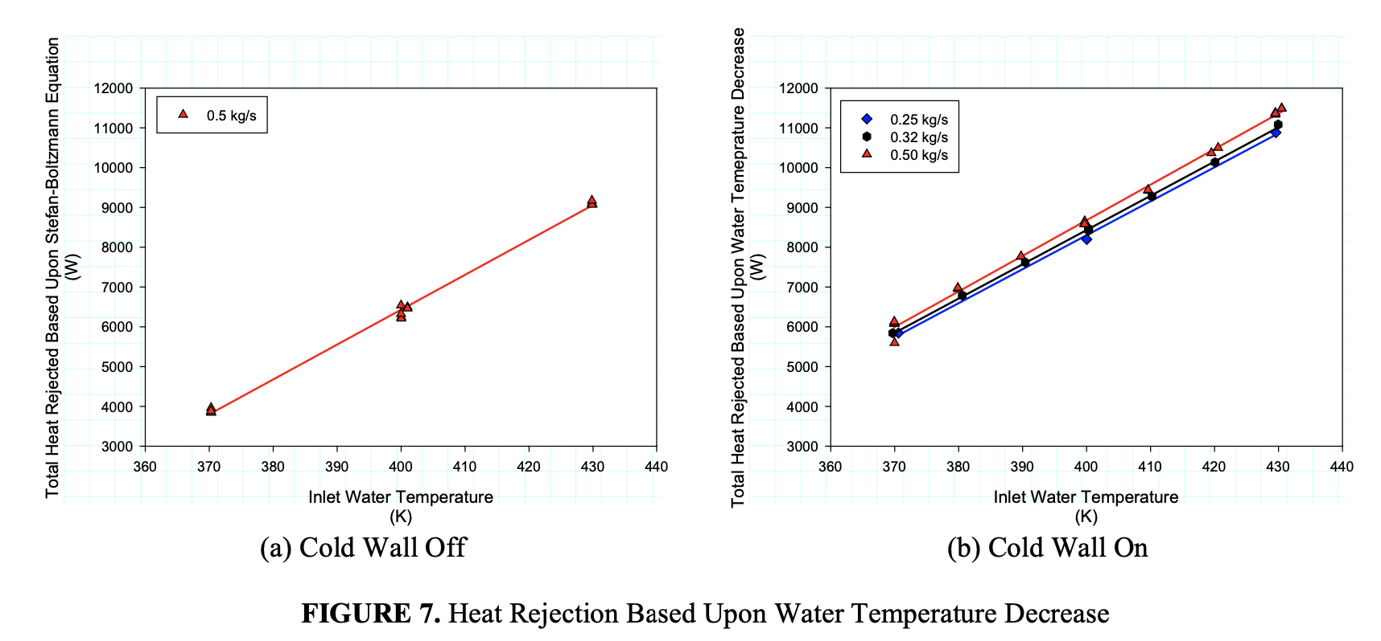
Summary of the Manufacture, Testing and Model Validation of a Full-Scale Radiator for Fission Surface Power Applications
Authors: David Ellis, John Siamidis (NASA Glenn), James Calder (Material Innovations Inc., Huntington Beach, CA)
Summary:
Manifolds made from Grade 2 Ti, graphite foam saddles to connect heat pipes to face sheets, graphite fiber - cyanate ester polymer matrix face sheets for heat rejecting surface
Average heat rejection for a single manifold is 73% of two-manifold operating

Slide 8
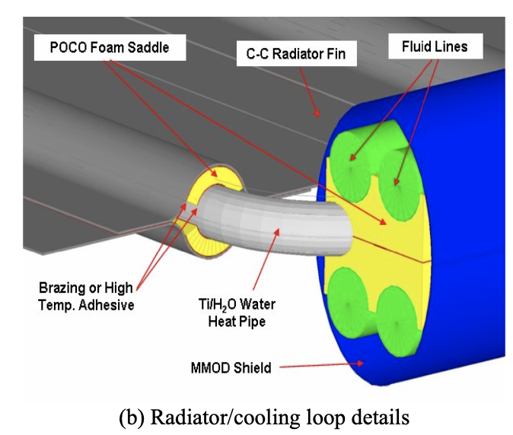
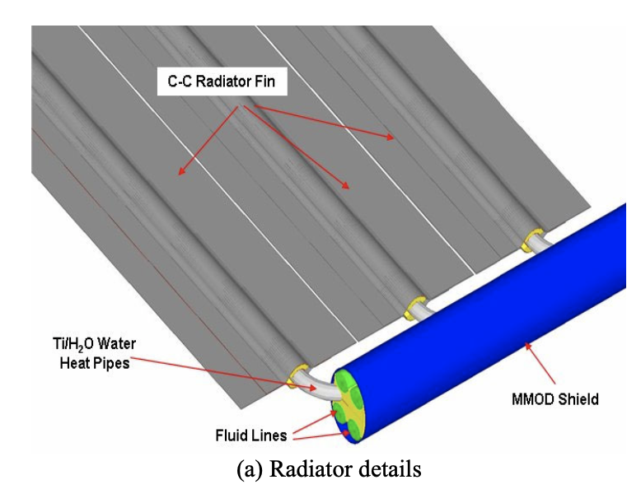
Coolant Options for Heat Pipes
NaK vs Ti-water, halides

Slide 9
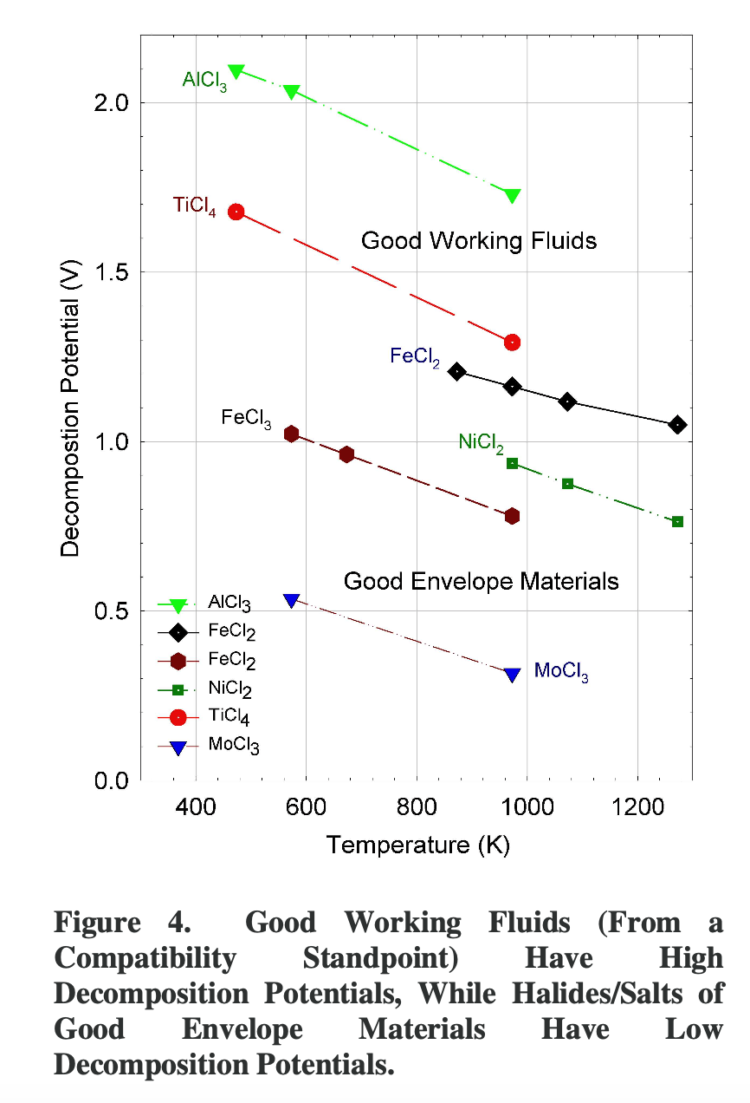
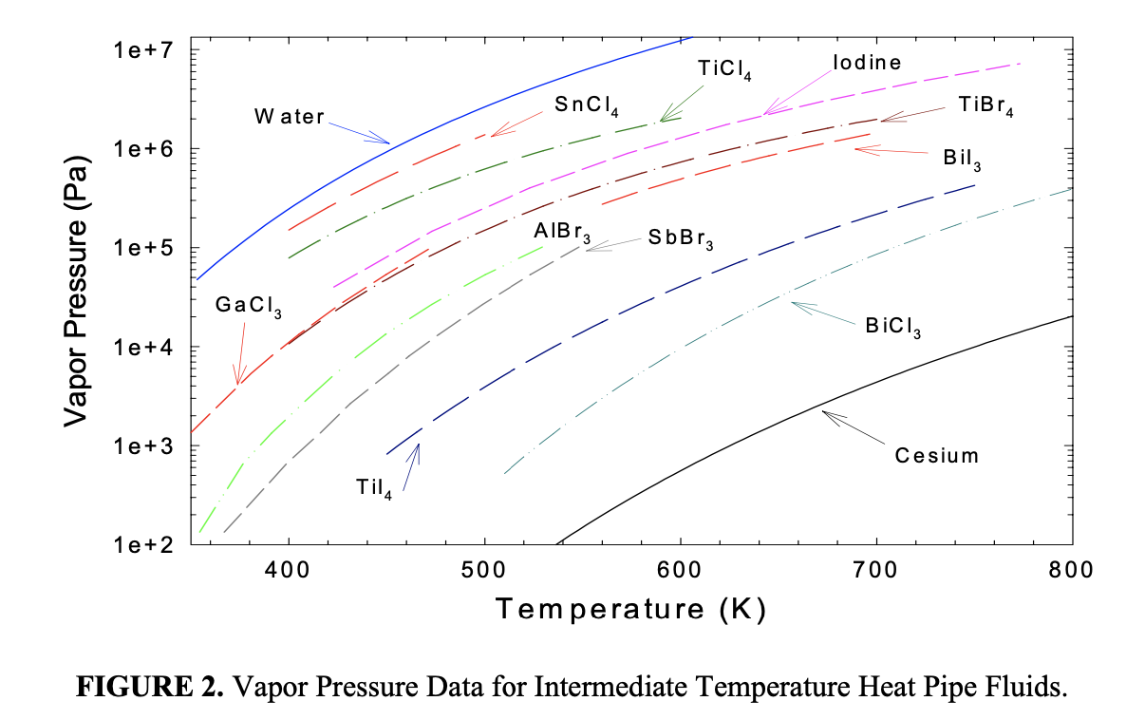
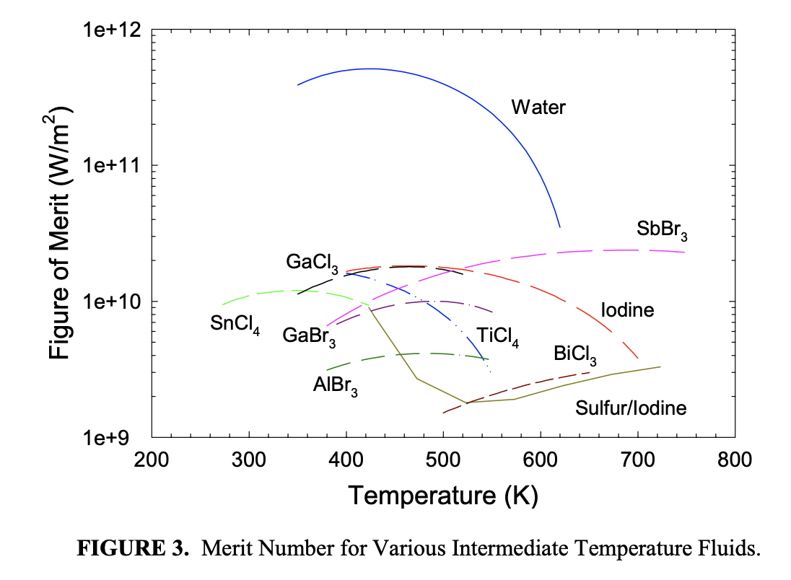
Thermo-Physical Properties of Intermediate Temperature Heat Pipe Fluids
Authors: Angirasa Devarakonda (Sest Inc.), William Anderson (Advanced Cooling Technologies)
Summary:
Water is well established for < 400 K, alkali metal pipes work well at > 700 K
Potential application of halides based on vapor pressure and merit number
Materials with high decomposition potential should be good working fluids (AlCl₃, TiCl₄), materials with low decomposition potential (molybdenum, iron) should be good materials for envelope

Slide 10
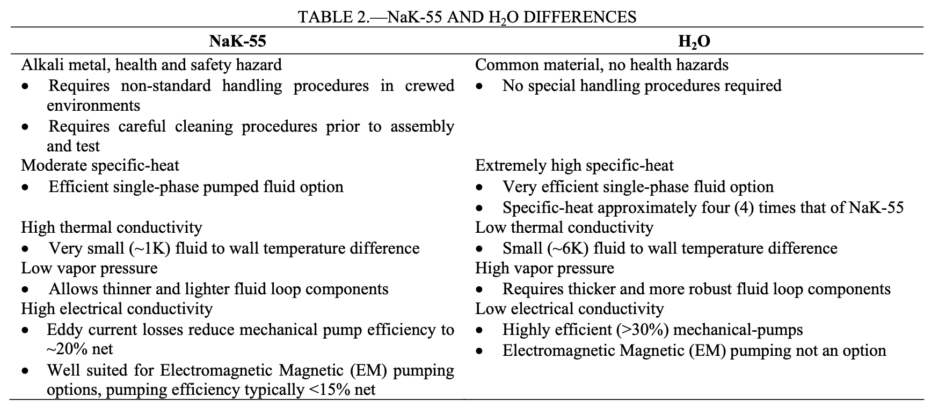
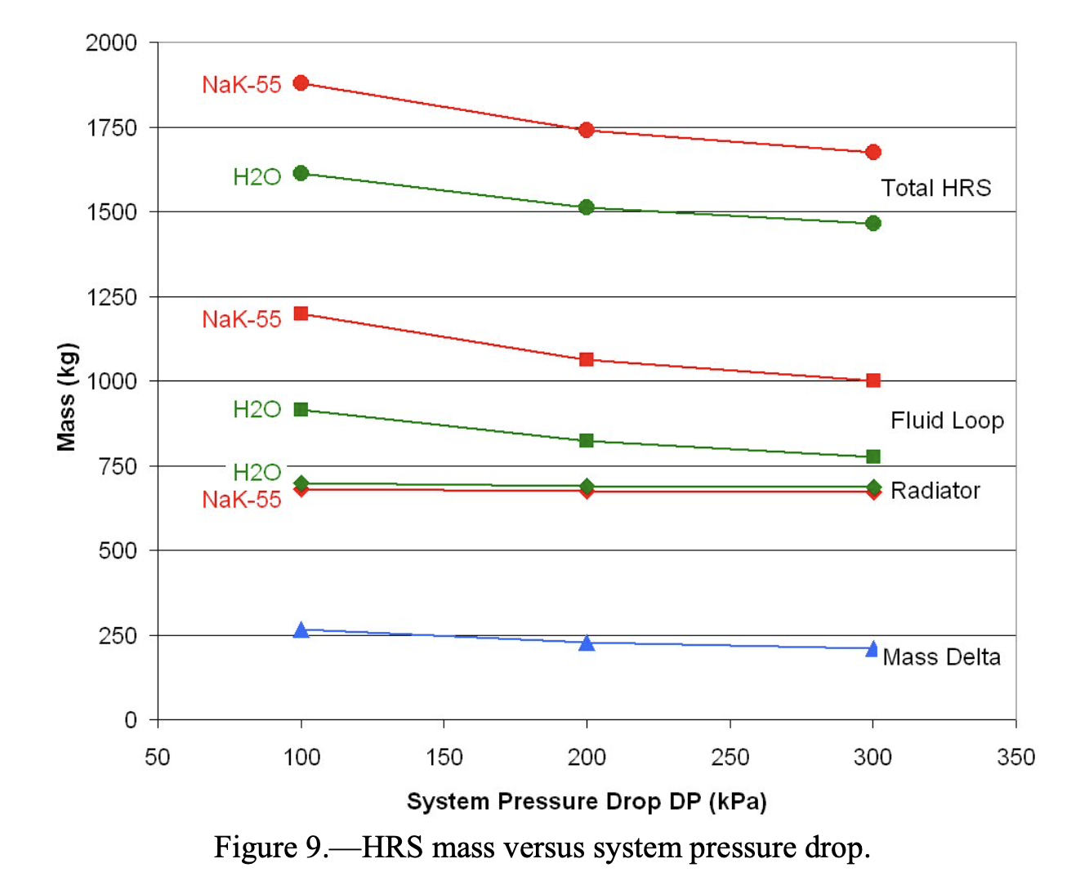
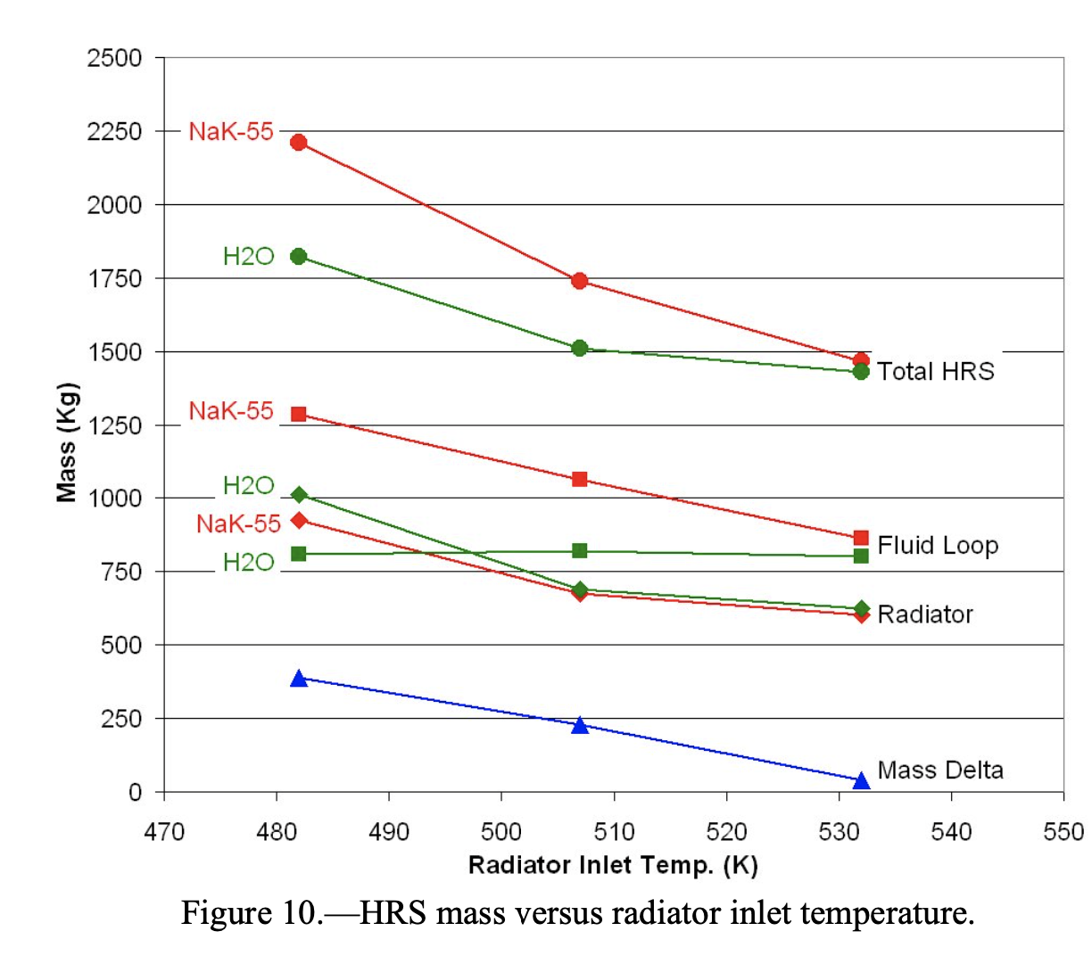
A Comparison of Coolant Options for Brayton Power Conversion Heat Rejection Systems
Authors: John Siamidis (Analex Corporation), Lee S. Mason (NASA Glenn)
Summary:
Comparing NaK and water as coolant options
Overall mass savings achieved when using water compared to NaK even though heat pipes need to be slightly thicker and heavier
Mass savings apply even as system pressure decreases and radiator temperature increases, less safety and compatibility issues

Slide 11
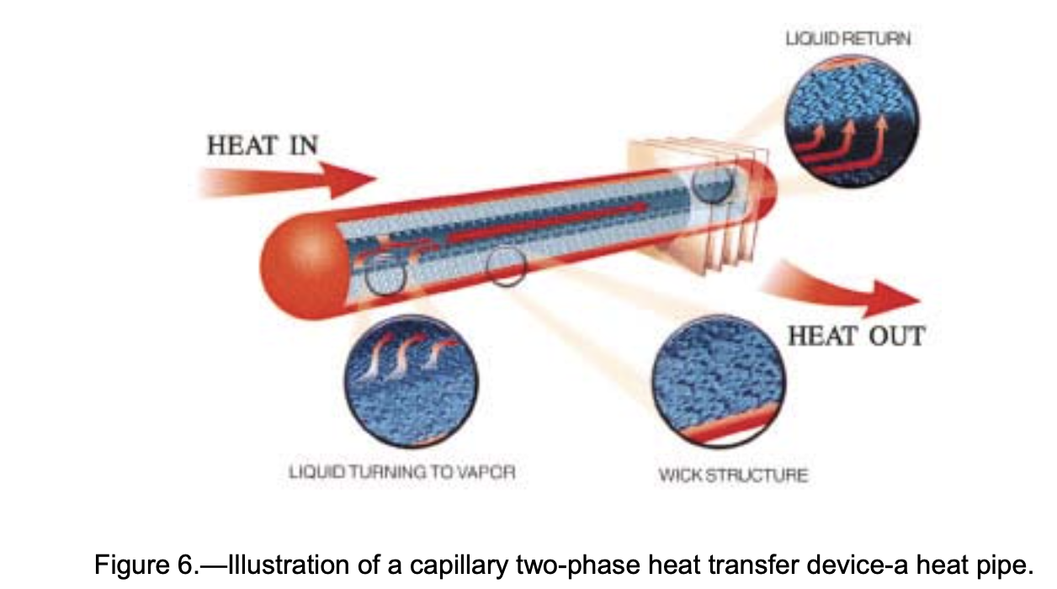
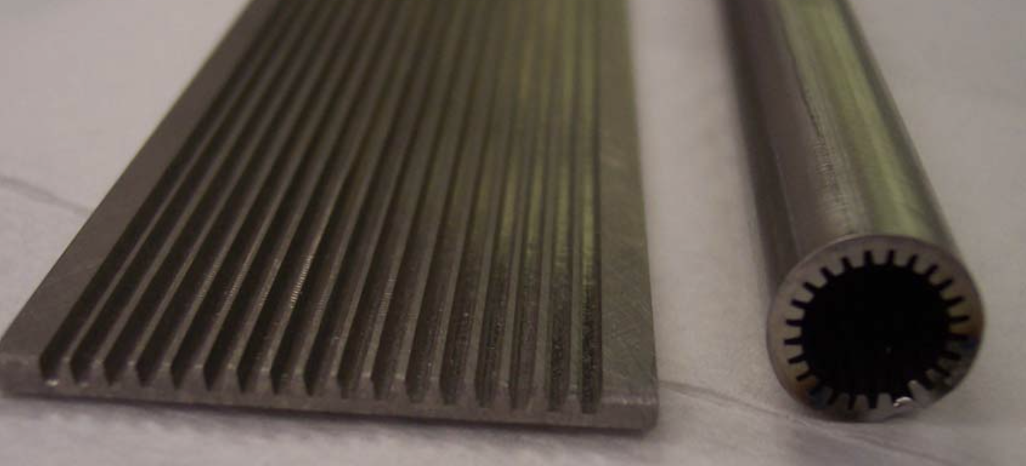
Titanium Water Heat Pipes Overview and Testing

Slide 12
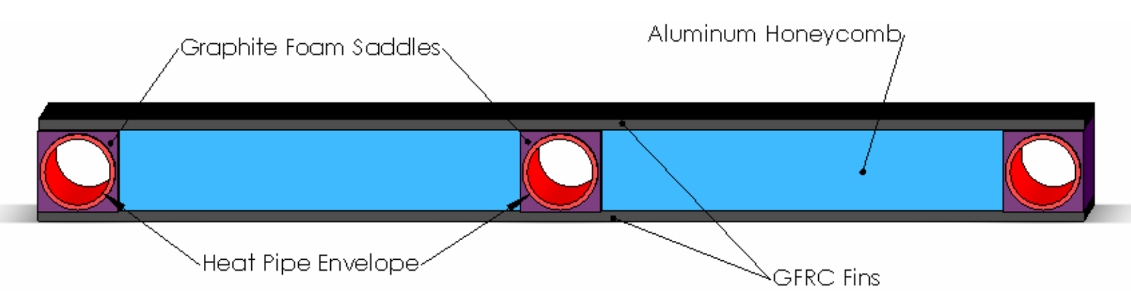
High Temperature Titanium/Water and Monel/Water Heat Pipes
Authors: William Anderson, Peter Dussinger, Richard Bonner, David Sarraf (Advanced Cooling Technologies)
Summary:
New fabrication method for titanium heat pipes explored (cannot be extruded like aluminium)
Using grooved wicks for simplicity
Graphite foam saddles used to bond heat pipes to radiator fins

Slide 13
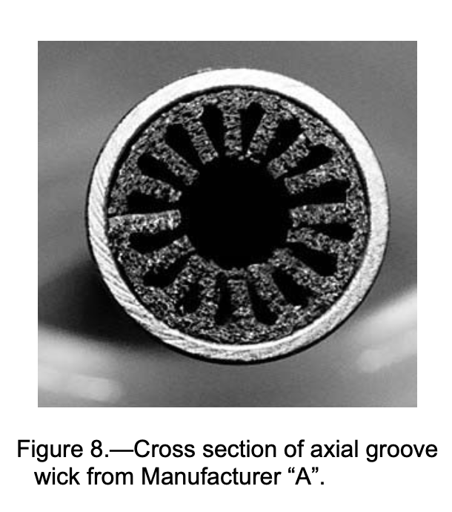
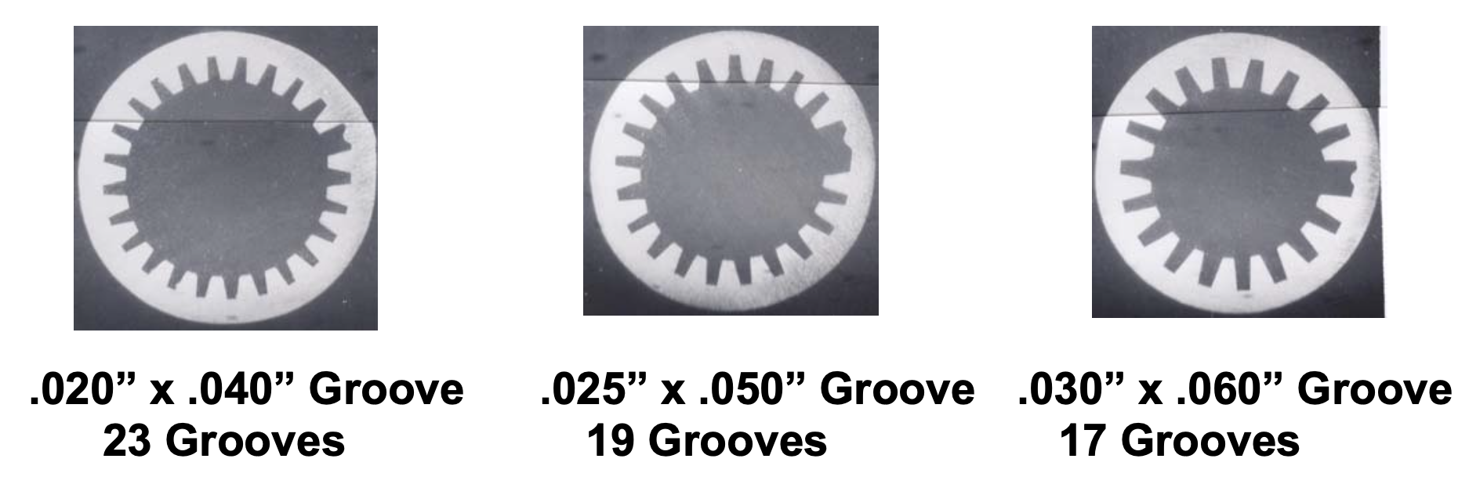
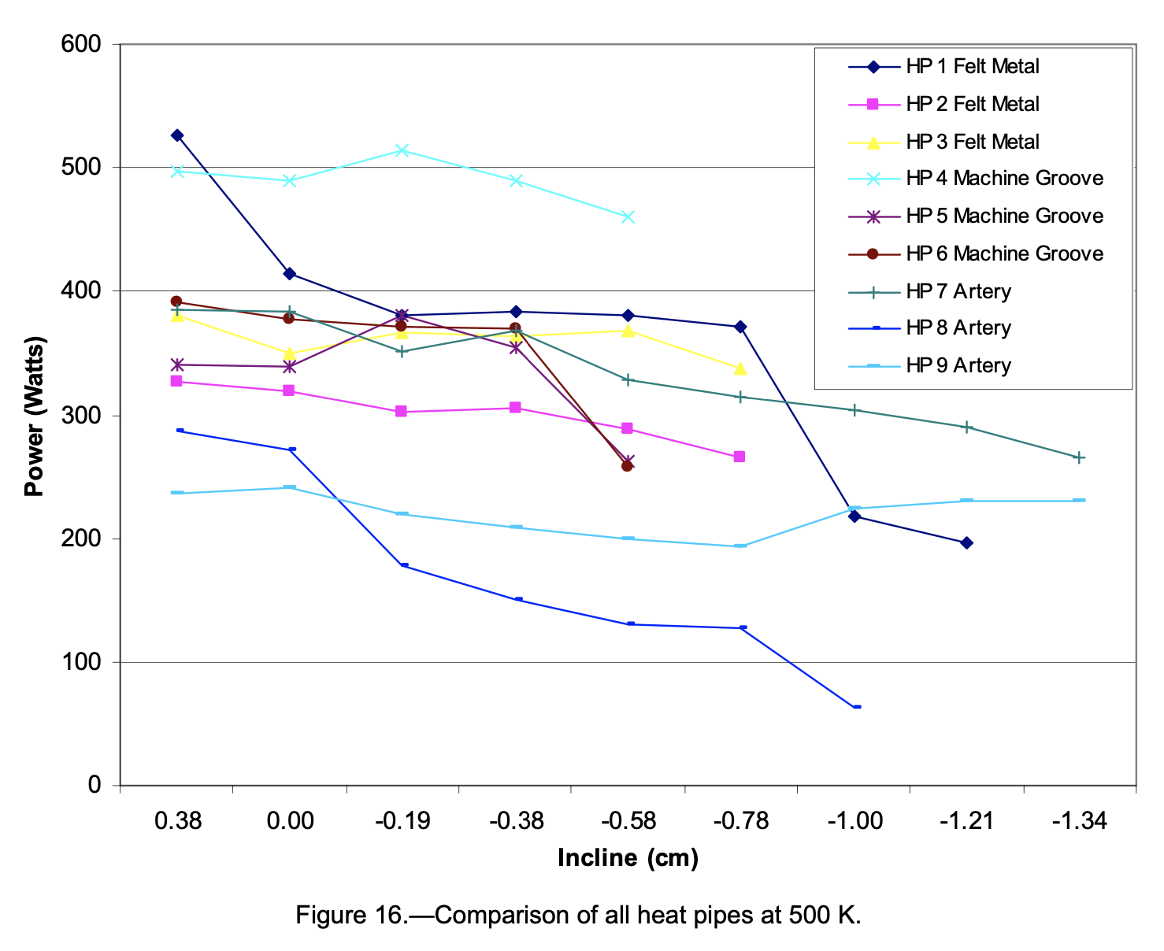
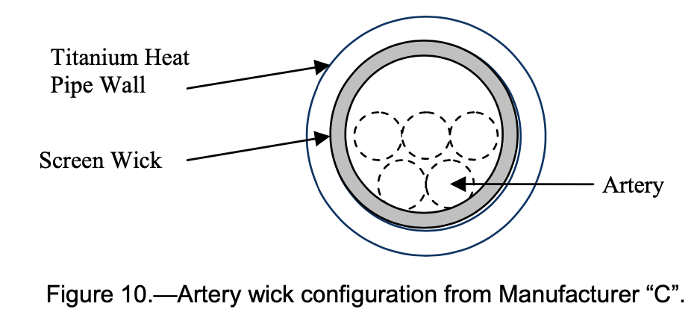
Thermal Performance of High Temperature Titanium-Water Heat Pipe by Multiple Heat Pipe Manufacturers
Authors: James Sanzi (Sest Inc.)
Summary:
Performance evaluation of heat pipes with different wicks
Thermocouple measurements show felt metal and machined groove heat pipes perform similarly and slightly better than artery screen heat pipes
However, screen artery heat pipes show better performance at higher inclinations
Best heat pipes reject 500 W at 500K operating temperature

Slide 14
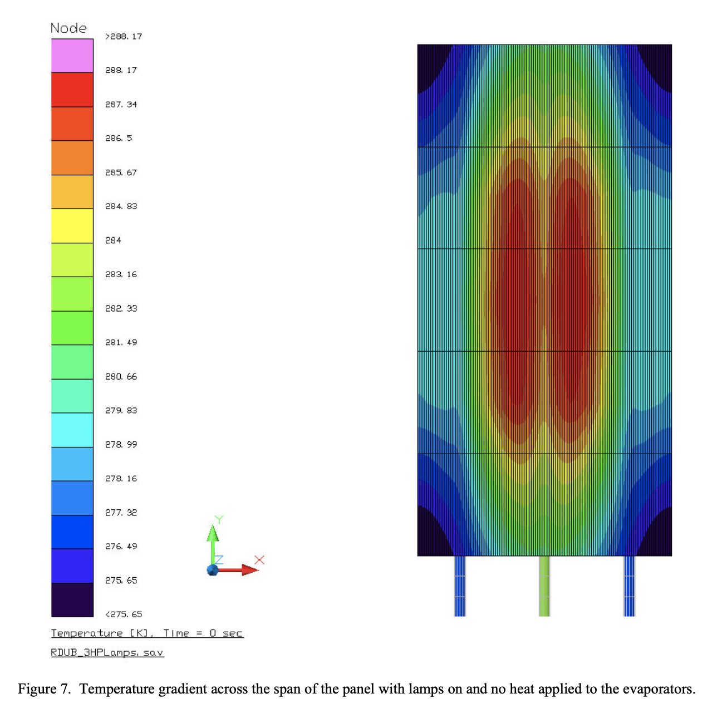
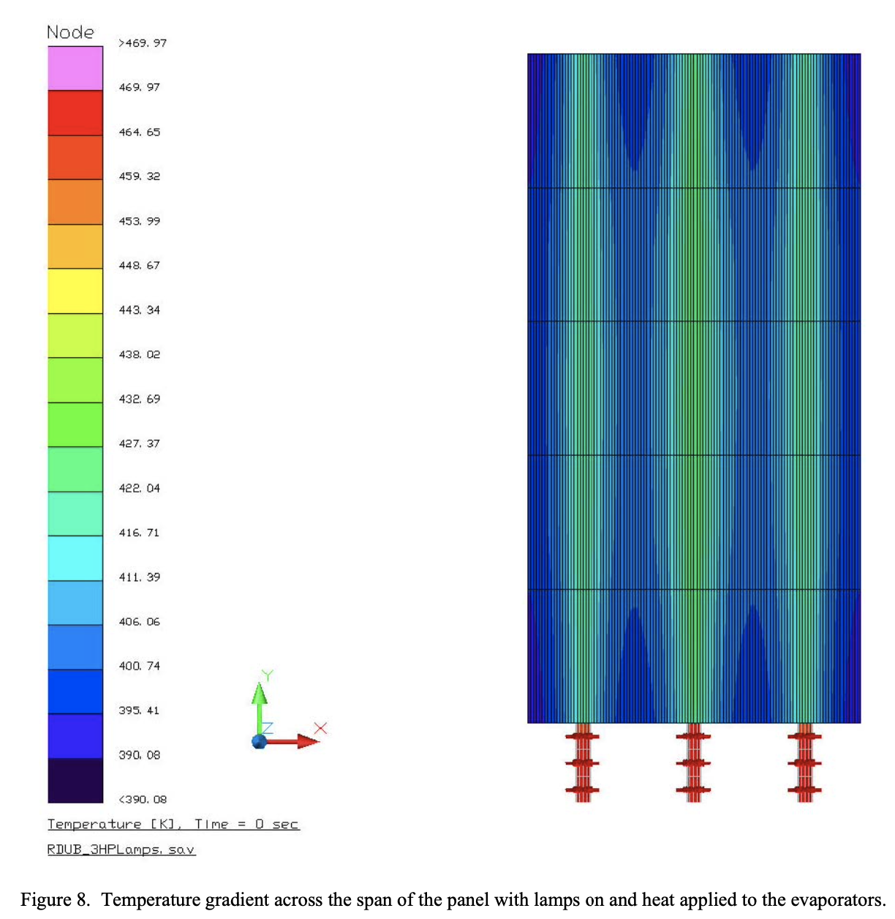
Cold Start of a Radiator Equipped with Titanium-Water Heat Pipes
Authors: Donald Jaworske, John Siamidis (NASA Glenn Research Center), James Sanzi (Sest Inc)
Summary:
Simulating lunar conditions where water is frozen so it is necessary to thaw heat pipes
Sun illumination is not enough to thaw heat pipes, additional evaporator wattage needed
High thermal conductivity of facesheet offers the possibility of a cascading start by starting one heat pipe and allowing heat flow through the face sheet to melt the water in the next heat pipe

Slide 15
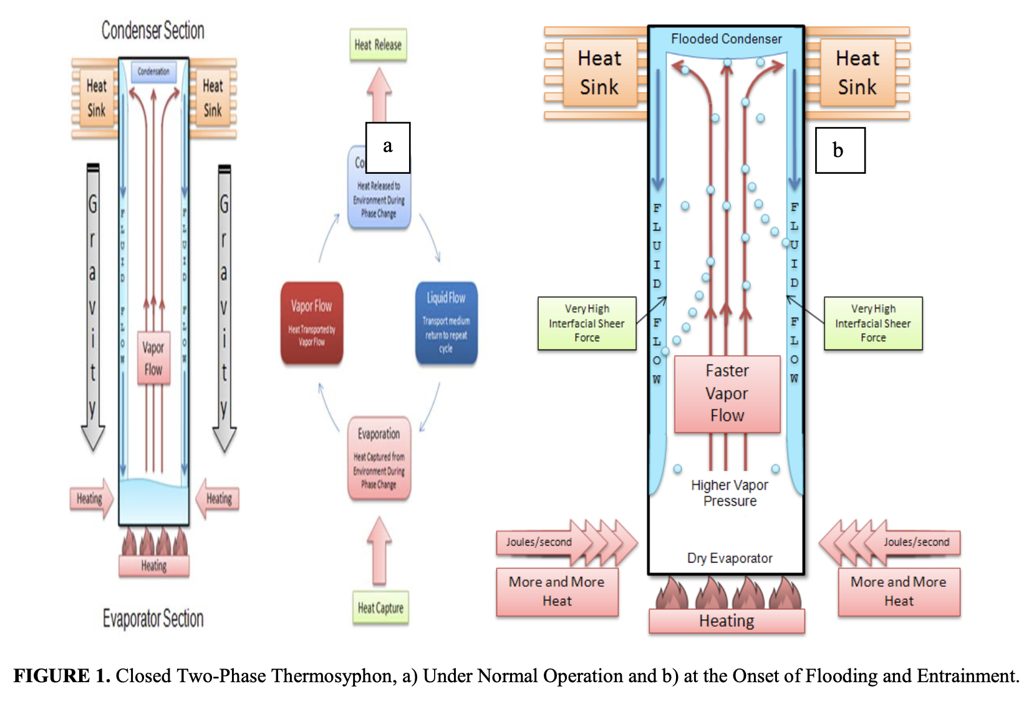
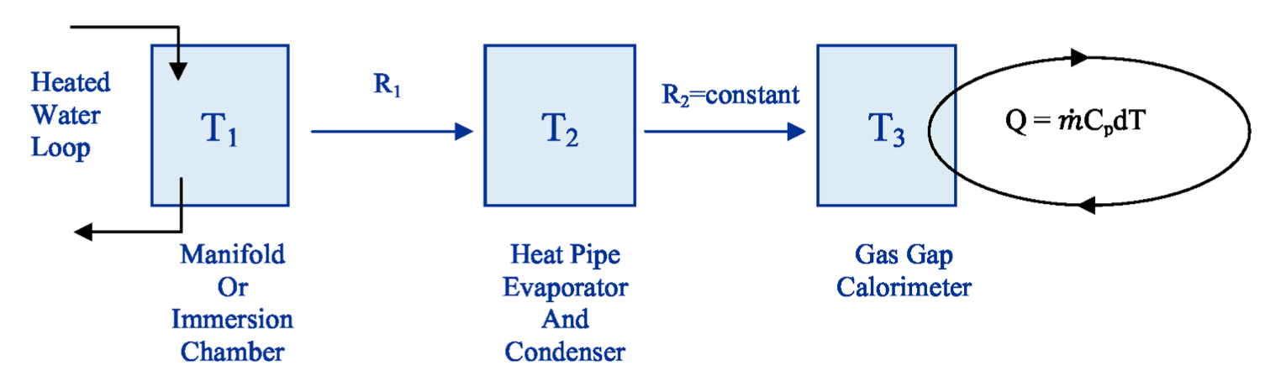
Thermosyphons
A subset of heat pipes that operate in a gravity field, liquid in evaporator gets transferred to condenser where it returns via capillary action

Slide 16
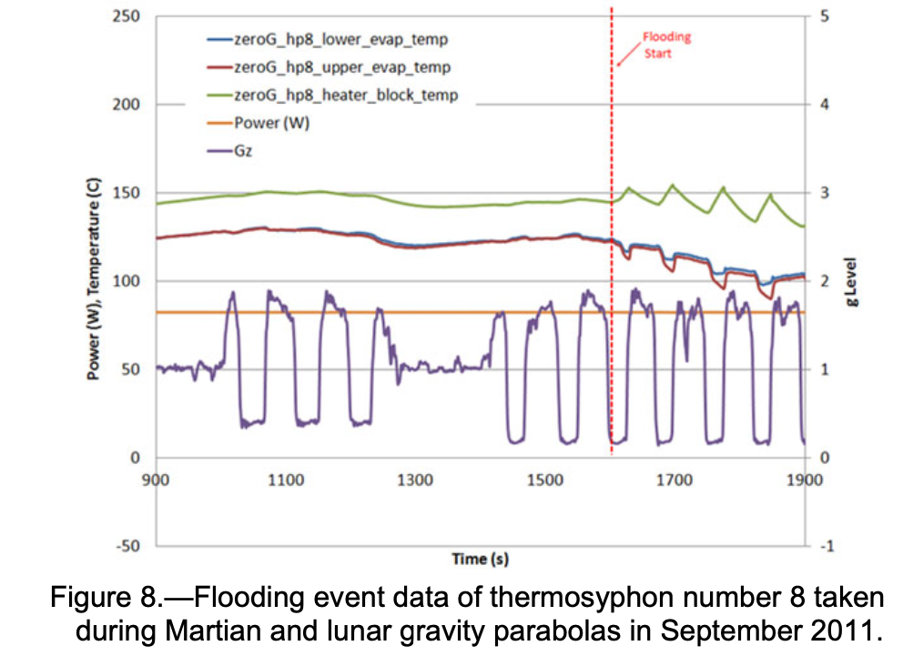
Thermosyphon Flooding in Reduced Gravity Environments Test Results
Authors: Marc Gibson, Donald Jaworske (NASA Glenn), James Sanzi (Sest Inc.), Damir Ljubanovic (Gilcrest Electric)
Summary:
Condenser flooding phenomenon: gravity forces acting on the condenser fluid cannot overcome shear forces created by vapor escaping evaporator throat which stalls heat transfer
Specific amount of fluid used to make sure thermosyphon functions properly (2.0 g)

Slide 17
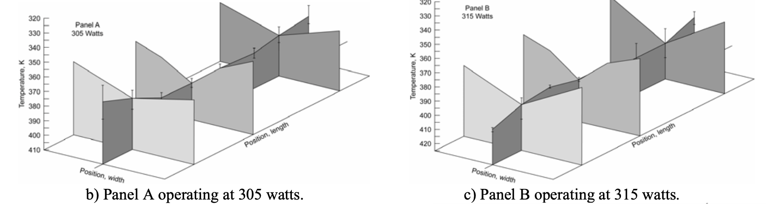
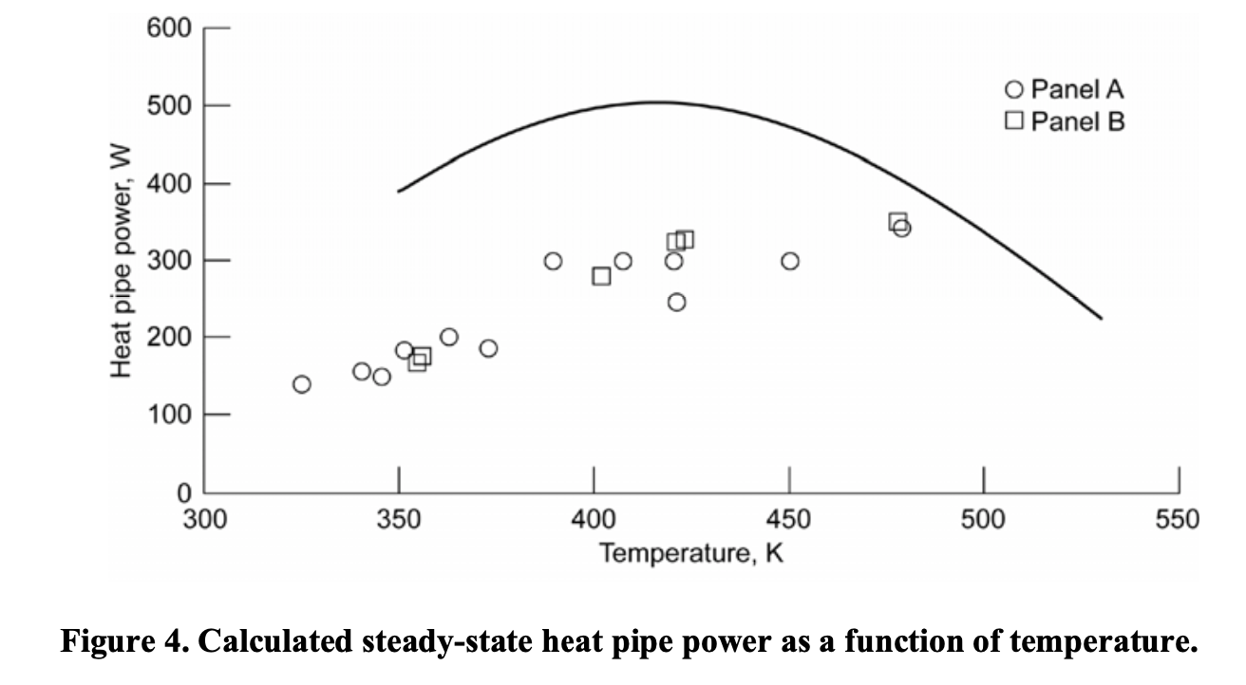
Heat Rejection Systems Utilising Composites and Heat Pipes: Design and Performance Testing
Authors: Donald Jaworske, Duane Beach (NASA Glenn), James Sanzi (Sest Inc)
Summary:
Combining polymer matrix composites with heat pipes to minimise mass and increase performance
High thermal conductivity thermal fibers successfully spread heat (independent of polymer matrix used) but mixed panel performance (poor conductance through adhesive layers and low areal density of contact between graphite and interface)

Slide 18
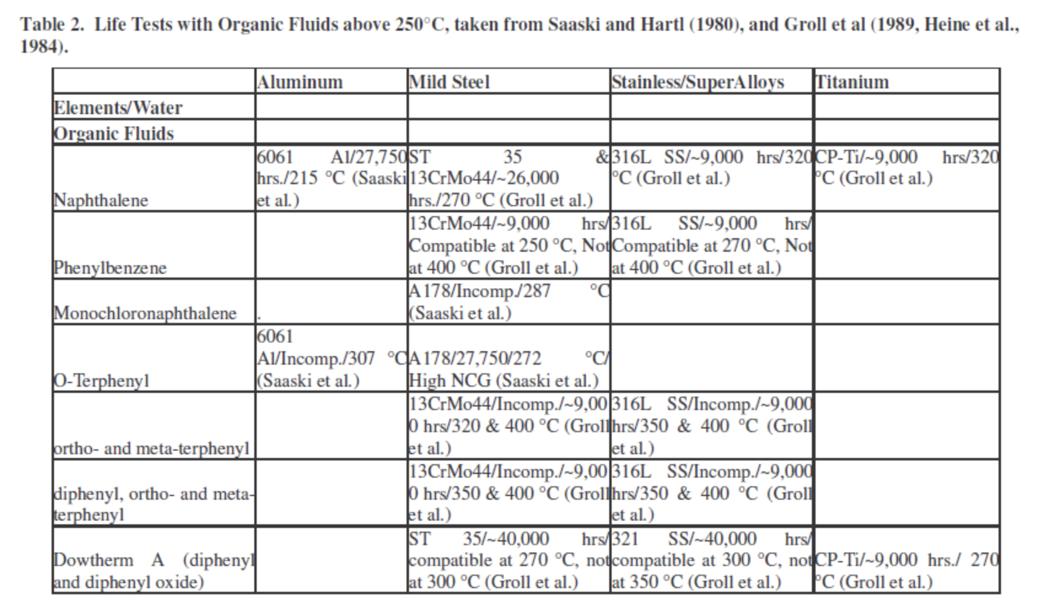
Halide Compatibility
Electrochemical theory to test compatibility (Saaski and Hartl, 1980)

Slide 19
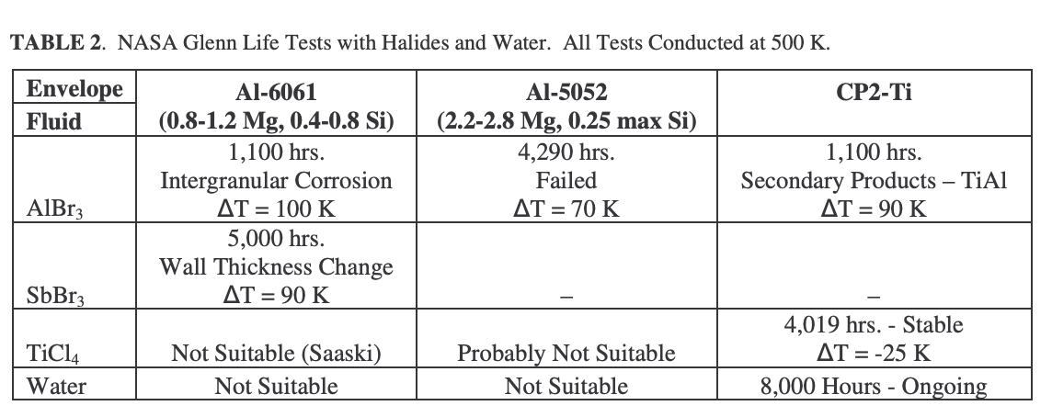
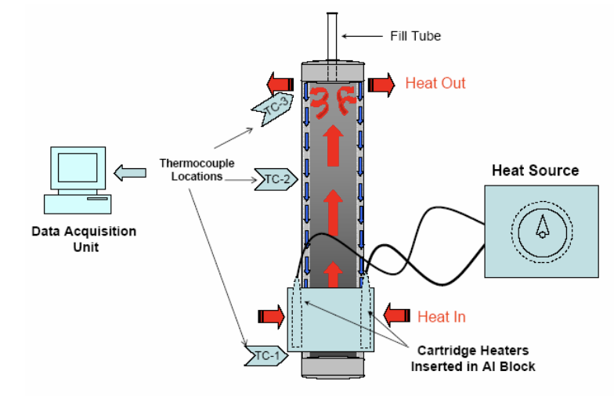
Halide Compatibility
Electrochemical method to test compatibility (Tarau et al. 2007)
Predicts probability of reaction between a halide and a metal envelope

Slide 20
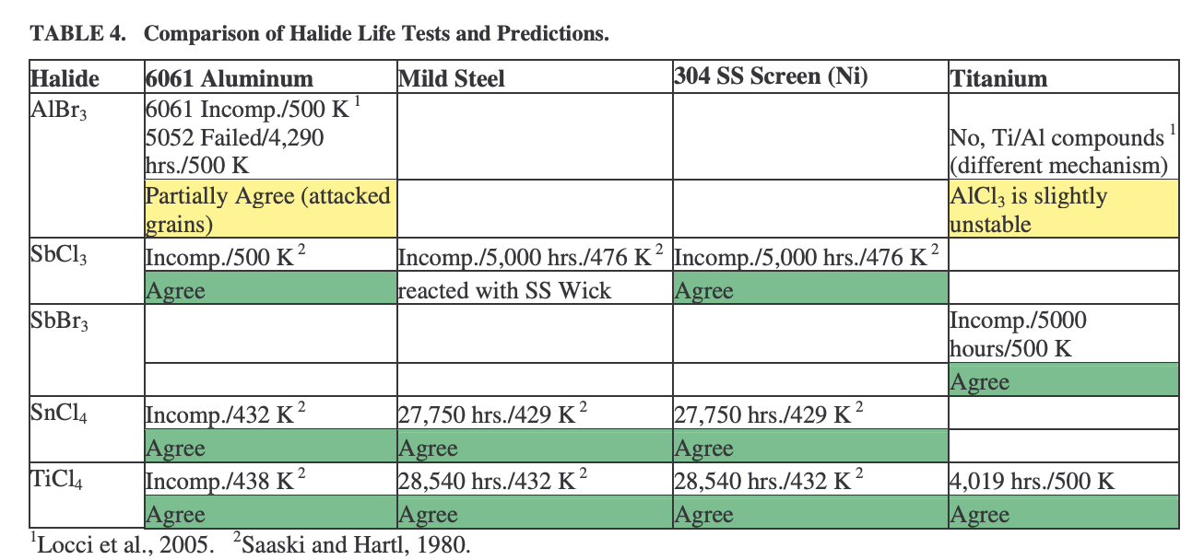
Halide Compatibility
Electrochemical method to test compatibility (Tarau et al. 2007)
SbCL₃ is incompatible with Al-6061 tested pipe
AlBr₃ reacts with Al envelope at grain boundaries, forming TiAl compounds

Slide 21
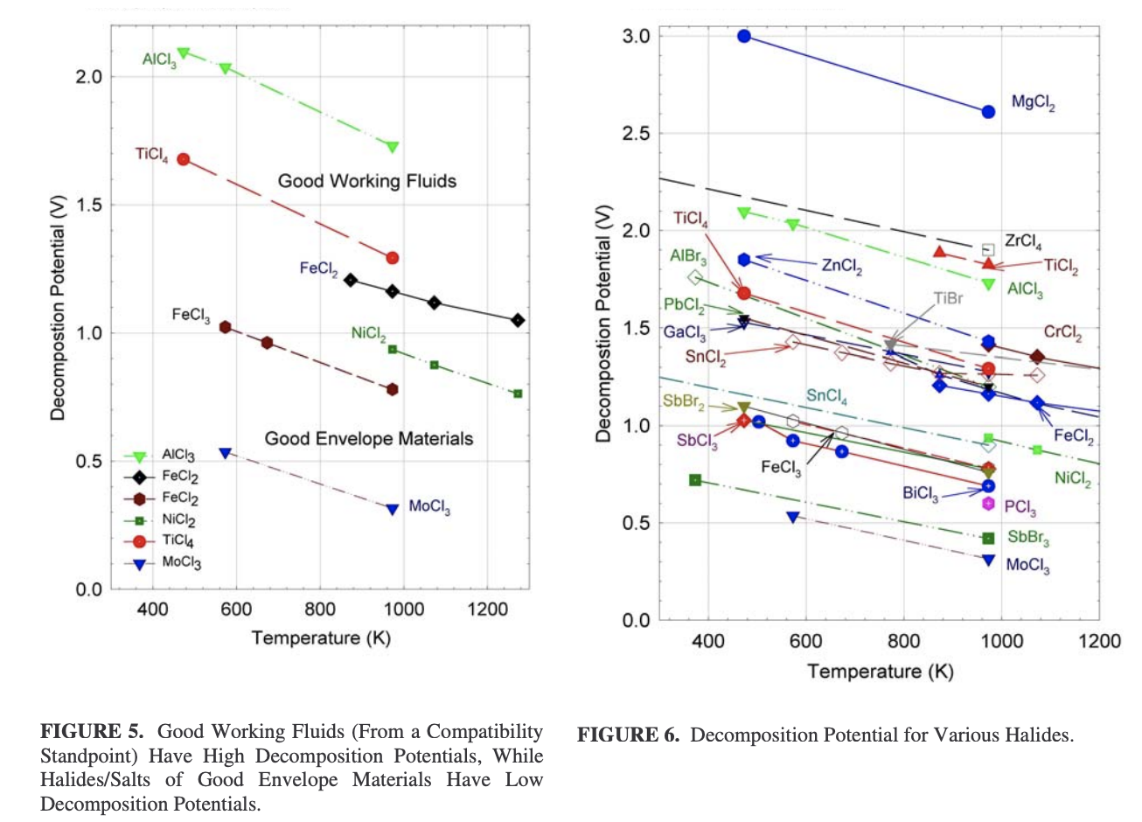
Halide Compatibility
Electrochemical method to test compatibility (Tarau et al. 2007)
AlCl₃ and TiCl₄ have high decomposition potential

Slide 22
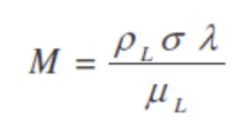
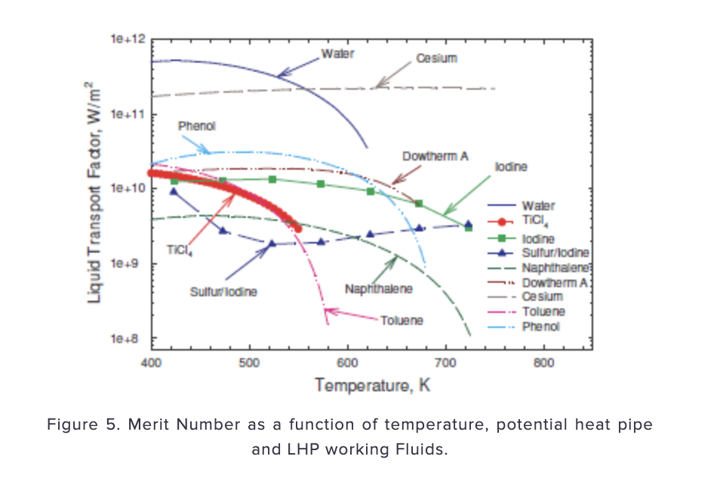
Liquid Transport Factor and Alternatives
Mercury
Dowtherm fluids
Sulfur/iodine mixtures
Napthalene
Phenol
Toluene
Halide salts
Higher merit number is better

Slide 23
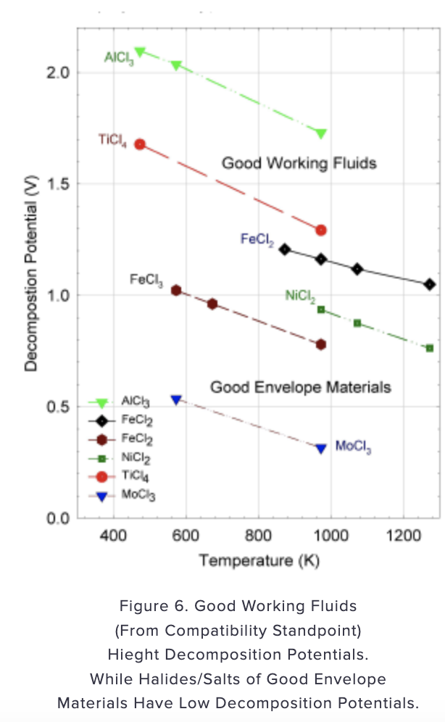
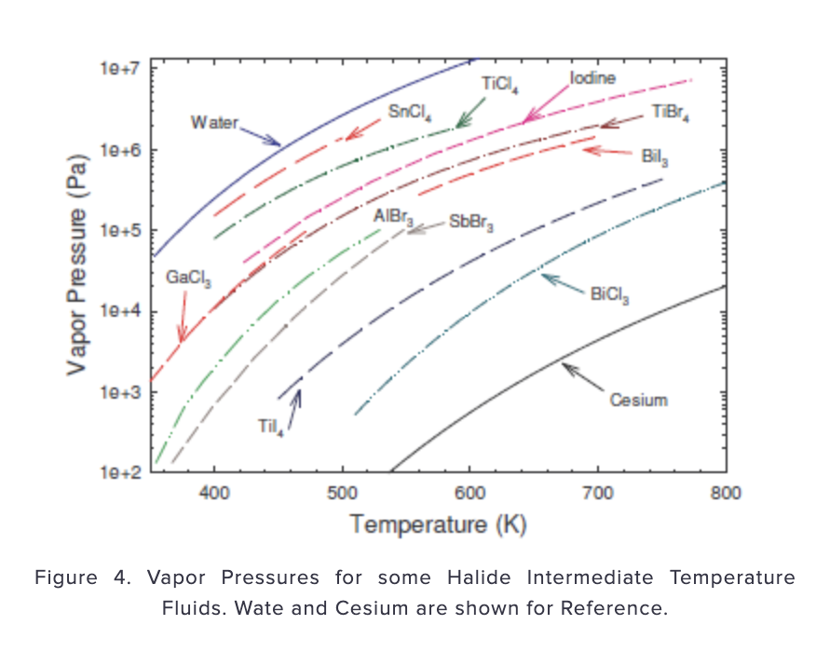
Liquid Transport Factor and Alternatives
Halides have lower vapor pressure compared to water but can operate at 500-600 K temperature range

Slide 24
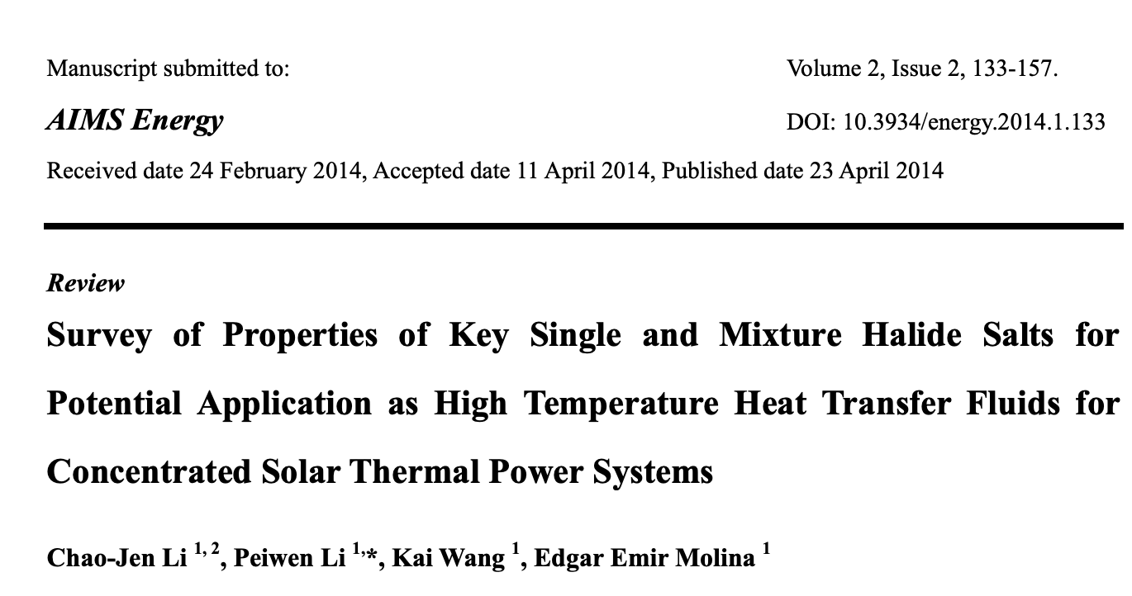
Halide/Fluoride Salts
Heat transfer fluids for concentrated solar power (Li et. al, 2014)
Eutectic mixture of biphenyl/diphenyl oxide (upper temperature of 673K)
Fluoride salts for space solar power (good transport props but handling issues)
Halide salts (AlCl₃, ZnCl₂, FeCl₃, NaCl, KCl) and binary salt mixtures
Melting points and vapor pressures given

Slide 25
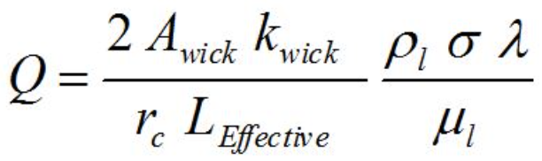
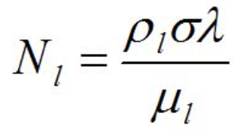
Merit number derivation
Only ranks fluids based on the capillary limit
Neglects vapor and gravitational pressure drops
Close to the triple point, the sonic limit and viscous effects control heat pipe power
Merit number variables: liquid density, surface tension, latent heat, viscosity (all related to temperature)

Slide 26
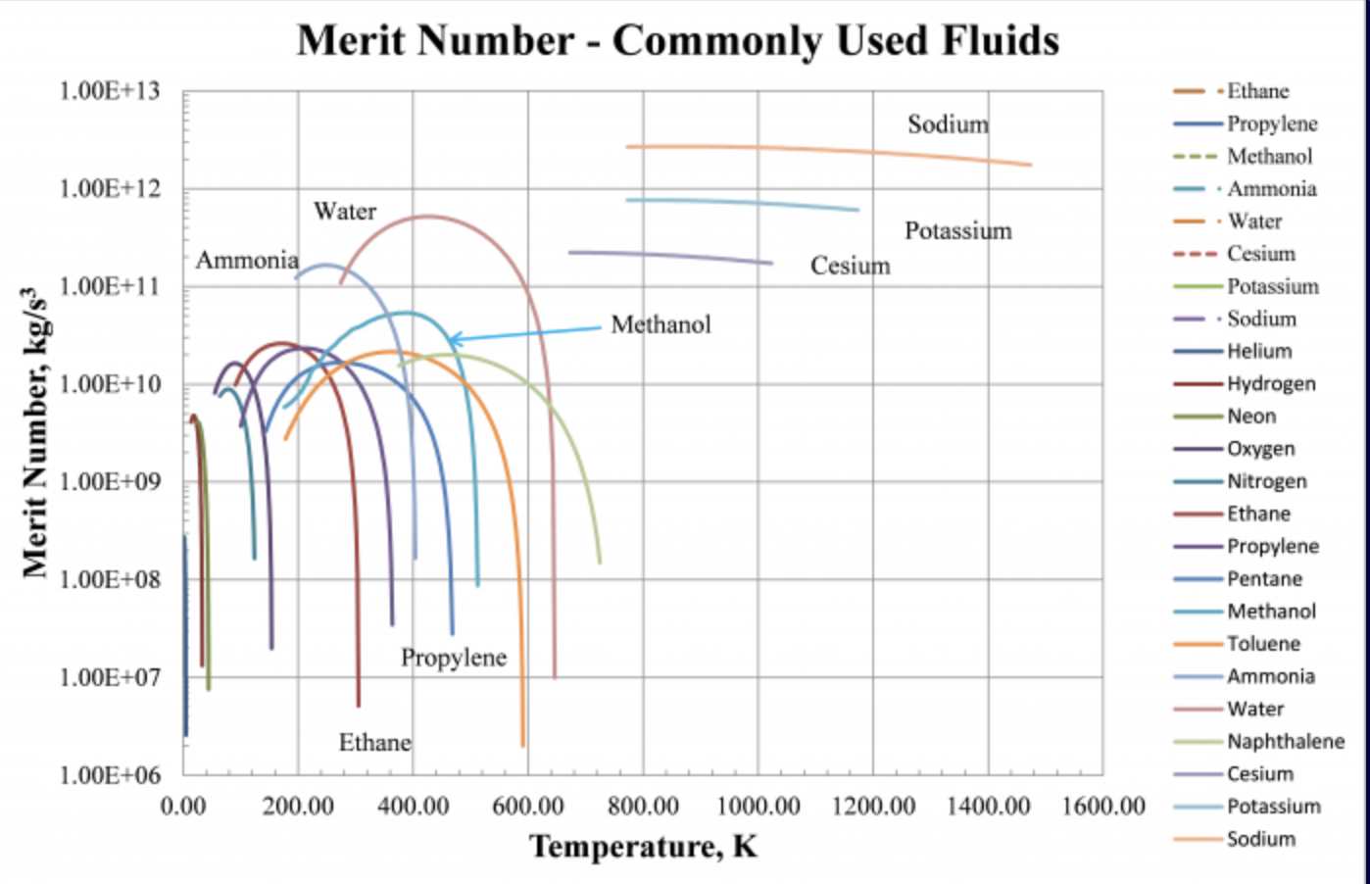
Compatibility definition
Need to have the highest merit number out of all possible options
Solubility with envelope material (lower is better)
Must be liquid and evaporate in the temperature range
Life tests give more information on degradation, corrosion, etc.

Slide 27
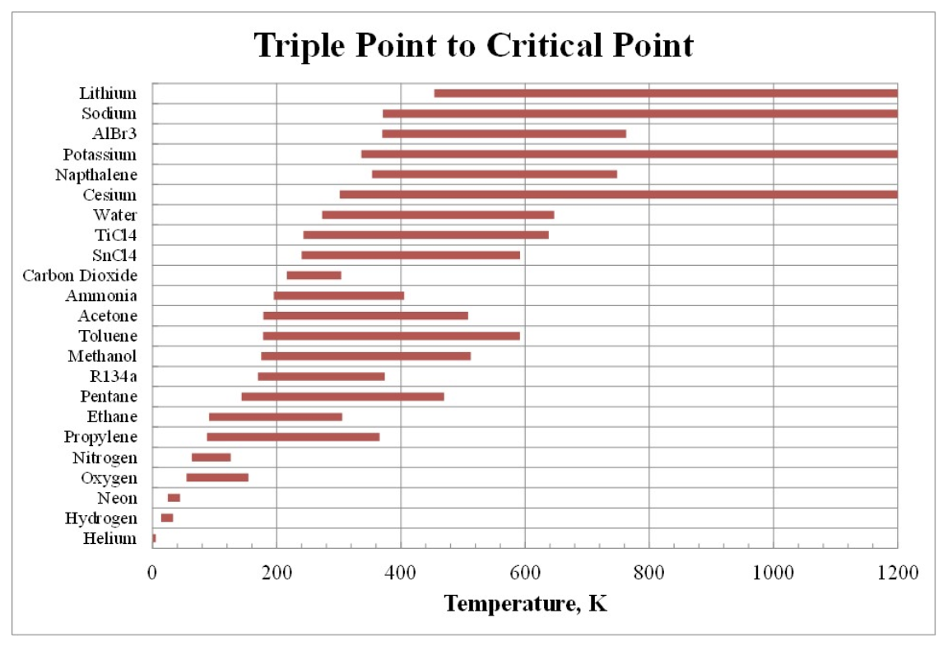
Compatibility definition
Working fluids theoretically operate from the triple point to the critical point
Heat pipe performance typically peaks in the middle of this range
Low vapor density at lower temperature range constrained by sonic limit
https://web.archive.org/web/20160316053304/http://www.1-act.com/intermediate-temperature-fluids-life-tests/

Slide 28
Incompatibility examples
Life tests tell us feasibility of working fluid/envelope pairs
Non-condensable gas generation
Corrosion
Material transport

Slide 29
Tasks done this week (5/1)
Define compatibility of working fluid
Working fluid property identification based on raw data
Consider handling issues of working fluid with aluminum nitride

Slide 30
Next Steps
Identify which applications are suitable for further investigation
Discuss in follow-up meeting with collaborator
Lab trainings

